Slide 1
Intelligent Identification of Breast Cancer Empowered with Machine learning

Slide 2
Abstract
Every year many people die due to the late diagnosis of cancer. Early detection of this deadly disease can reduce mortality rates.
Breast cancer is one of the significant types of cancer and regularly recognized malignant growth among women and necessary explanation behind expanding death rate among women.
The only way to decrease it is to diagnose it at early stages. Diagnostic errors by medical practitioners are considered one of the leading causes of death.
In this research, fusion-based, different machine learning algorithms were applied to diagnose breast cancer early. For this purpose, two datasets (images and Features based) were collected from Kaggle and IEEE-dataport.
The proposed model is trained on an image-based dataset using a convolutional neural network.

Slide 3
Aim
To design an effective and efficient health care model to predict breast cancer disease based on a fused Machine Learning approach.
Objective
Literature Review work on state of the art and popular approaches already used for breast cancer prediction.
Analyzing the datasets for better accuracy in minimum time to predict breast cancer in the health care sector.
Devising a new probabilistic approach fused based model for breast cancer prediction using machine learning.

Slide 4
Research Questions
What is the significance of predicting breast cancer stages by using a fused Machine Learning model?
How does the Machine Learning model can help to extend the accuracy of the proposed systems?
What are the parameters that involve in the evaluation of the breast cancer prediction system?

Slide 5
Literature Review
Computer-aided diagnosis (CAD) is a significant research area in medical imaging (Massion and Walker, 2014).
The basic idea of CAD is to use the quantitative output from an algorithm (computer software) as the "second opinion" to assist the radiologist in interpreting tasks related to disease detection (Doi, 2007).
CAD has two broad goals: first, to improve the radiologists' reading accuracy and consistency, and second to shorten the image interpretation time.
The general design of CAD is to detect (locate) suspect disease regions (e.g., a lesion) in one or several medical imaging modalities/images; and to generate a likelihood score for the presence of a particular disease.
These two designs correspond to CAD for disease detection and CAD for differential diagnosis (Doi, 2005).

Slide 6
Literature Review
CAD has been developed in various imaging modalities such as magnetic resonance imaging (MRI), CT, projection radiography, nuclear medicine, ultrasound, and digital pathology imaging; and is used for all parts of the body, including the head, thorax, heart, breast, liver, prostate, and bones.
Examples of CAD schemes developed in the past include pathological brain disease detection in MRI (Zhang et al. 2010; Zhang et al. 2011; Zhang et al. 2015) detection/diagnosis of breast lesions on mammograms (Gilbert et al.2018).
Typically, each CAD system is tailored for a specific disease and imaging modality. In general, these CADs depend on a conventional machine learning scheme, segmentation of the region of interest, feature extraction, and classification to make the final decision.

Slide 7
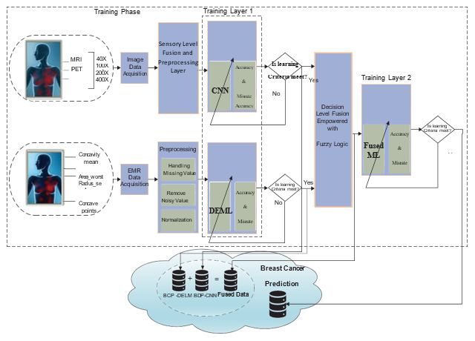
Methodology
Proposed Model for Breast Cancer Prediction System.

Slide 8
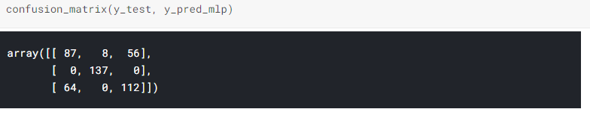
Model Results
After defining the model and fitting the neural network model to our training data, I got the following results. Following is an image showing the accuracy of the training and testing dataset:
Since I have dealt with a classification problem, I must evaluate it using the confusion matrix. The picture below shows the confusion matrix of our model:

Slide 9
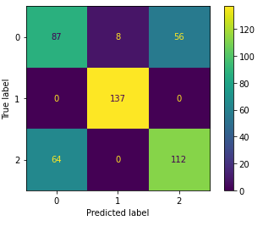
Model Result
The performance of the classification model can also be accessed via a classification report. The classification report of my model is as given next:
Let’s visualize the confusion matrix. The diagram of the confusion matrix as obtained in the evaluation of our model is as given below:

Slide 10
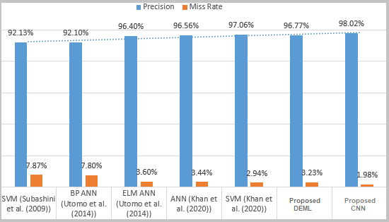
Model Result
I have also calculated the graph for accuracy per iteration (epoch) on training and validation data. The chart is obtained as a result of complete model training for 20 iterations and is shown below:

Slide 11
Conclusion
Breast cancer is one of the significant types of cancer and a substantial cause of death rate among women. The only way to decrease it is to diagnose it at early stages.
The preliminary determination of this research to design the automated system assists medical practitioners in diagnosing breast cancer disease by using machine learning techniques.
In our work conducted experiments based on two different datasets by using fusion enabled with CNN and DEML. I have also applied a variety of hand-crafted features better to understand the working of both CNN and handcrafted features.
The proposed method will use to analyze the stage of breast cancer quickly. The methodology in the present study showed the highest accuracy compared with previously reported studies on breast cancer diagnosis. This system will extensively change the conventional method, making the system more efficient, convenient, and personalized.

